Slide 1
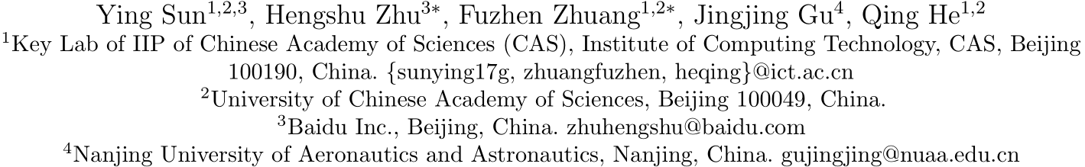
郑凯文
Exploring the Urban Region-of-Interest through the Analysis of Online Map Search Queries
2018 KDD
第24届ACM SIGKDD知识发现与数据挖掘国际会议论文集
Notes:
EDBT / ICDT研讨会主席
Nikolaus Augsten，奥地利萨尔茨堡大学
第28届地理标志 - 数据库基础研讨会

Slide 2
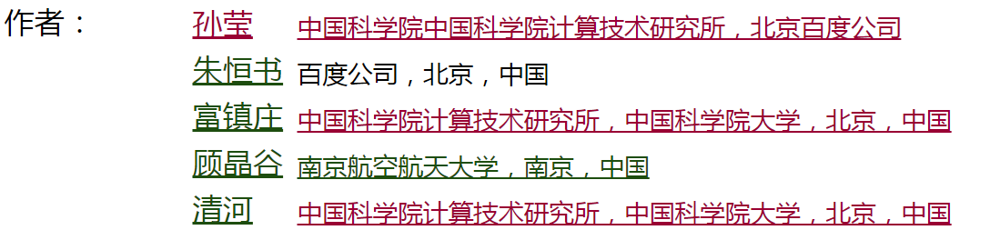



中国科学院计算技术研究所

Slide 3
Outline
1
Introduction
2
Our Approach
3
Experimental
4
Conclusion

Slide 4
Introduction
1

Slide 5
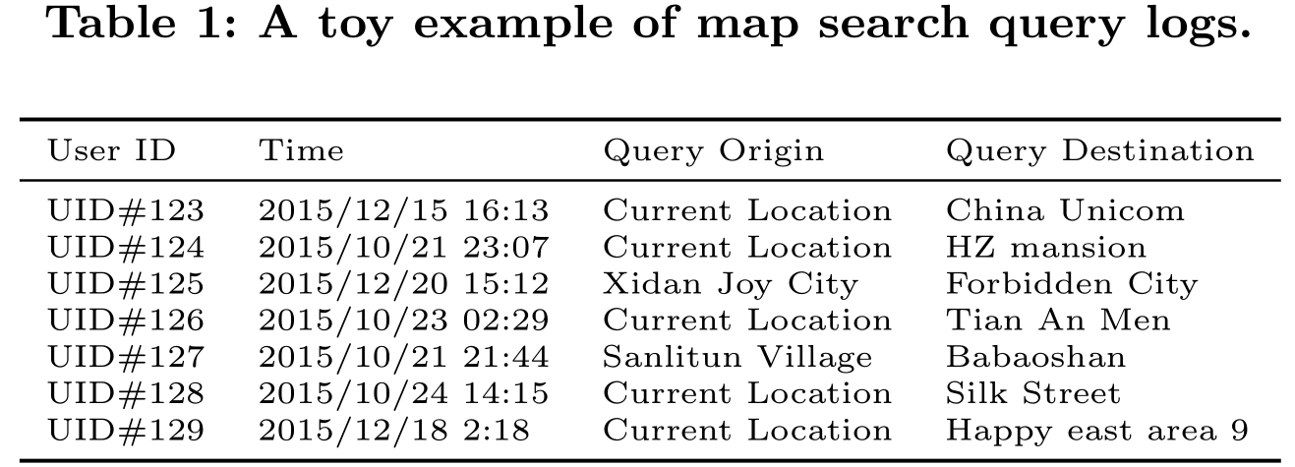
Introduction
People use online maps to find their way

Slide 6
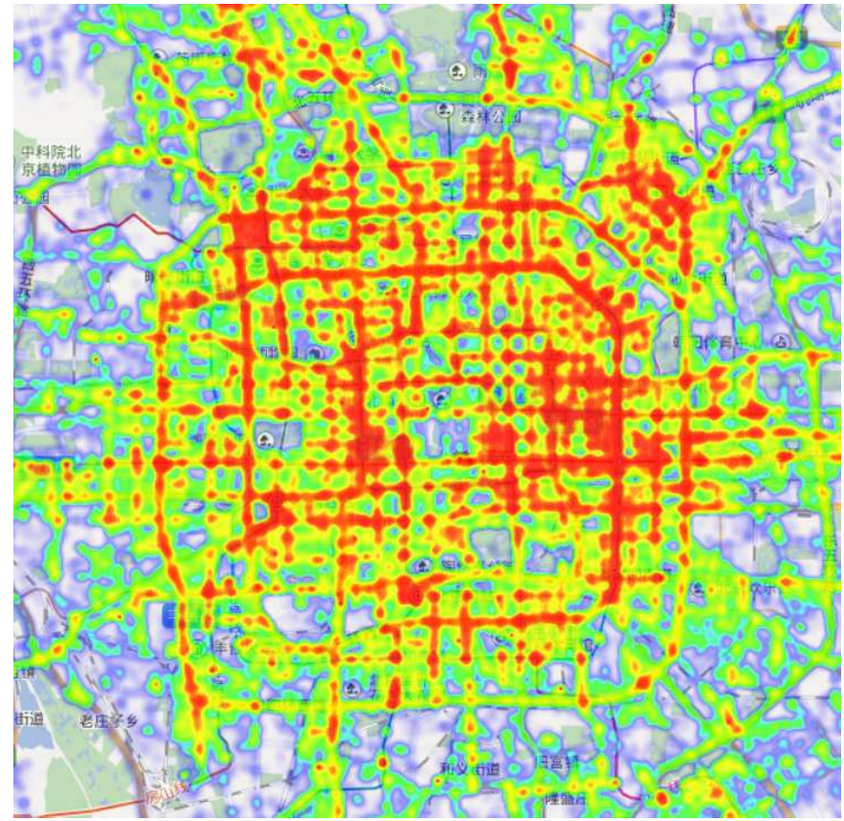
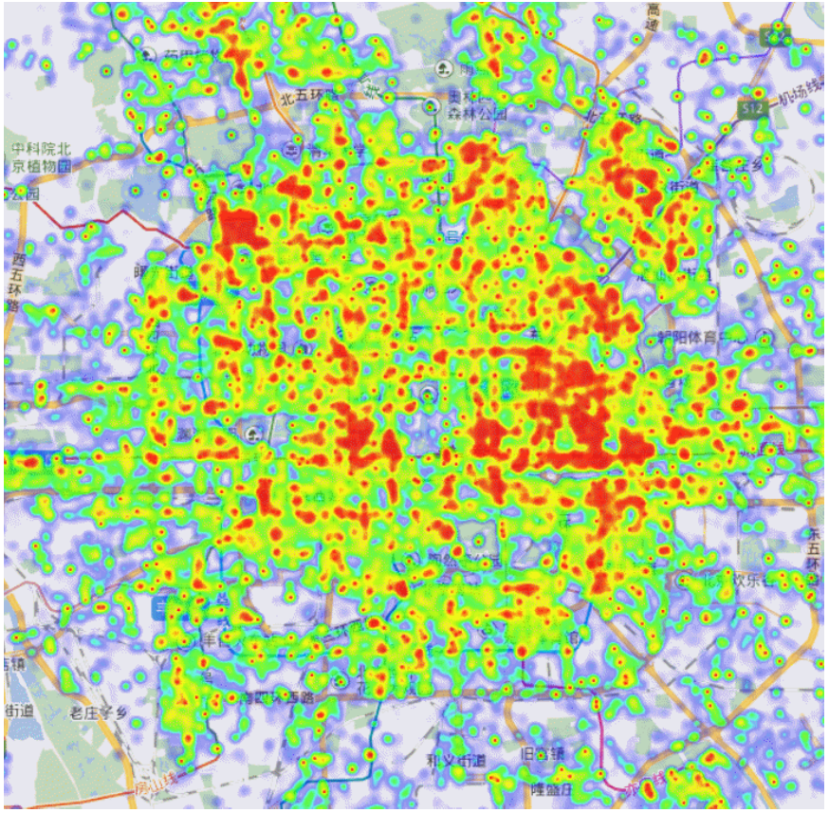
Introduction
Origin
Destination

Slide 7
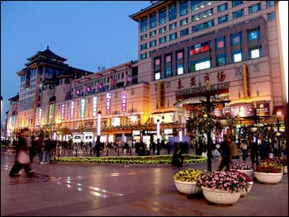
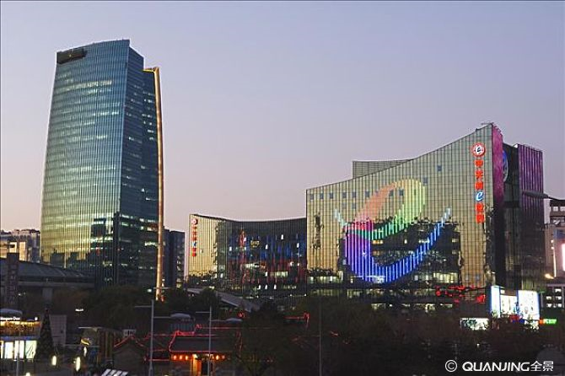
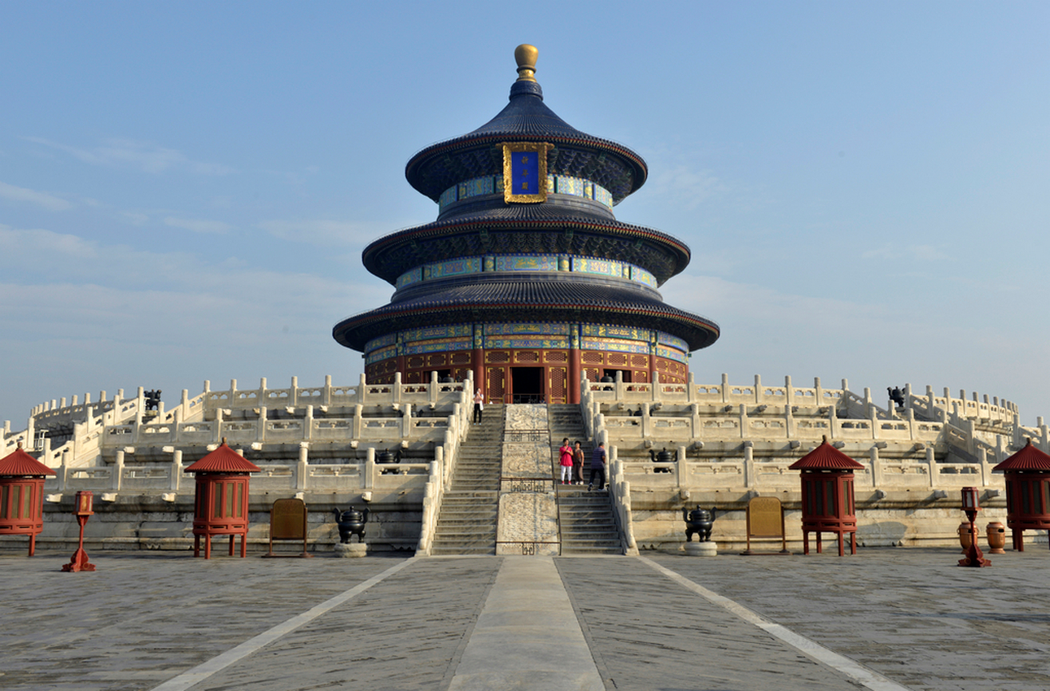
Introduction
Region-of-Interest (ROI)
Wangfujing
ZGC
Destination
Tiantan Park

Slide 8
Introduction
Region-of-Interest (ROI)
ROIs help us to know about the city
Positions & Functions Where do people go for shopping/hospital/food...
City development
Customer Origin Targeted advertising
Business site selection
Travel pattern over all understandings of the city

Slide 9
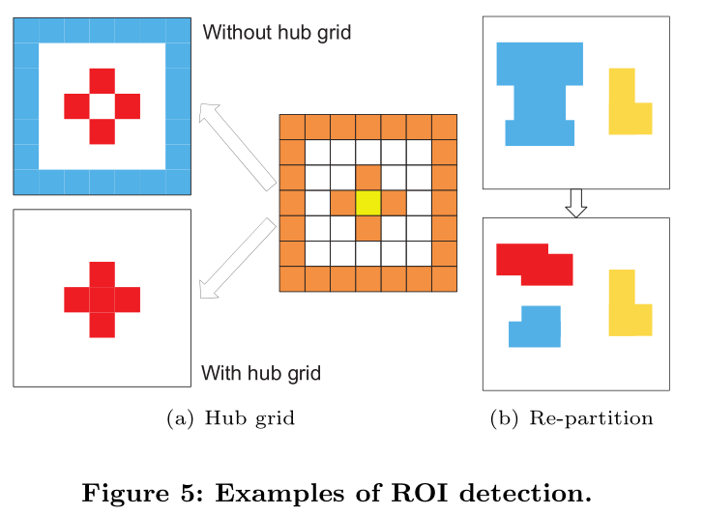
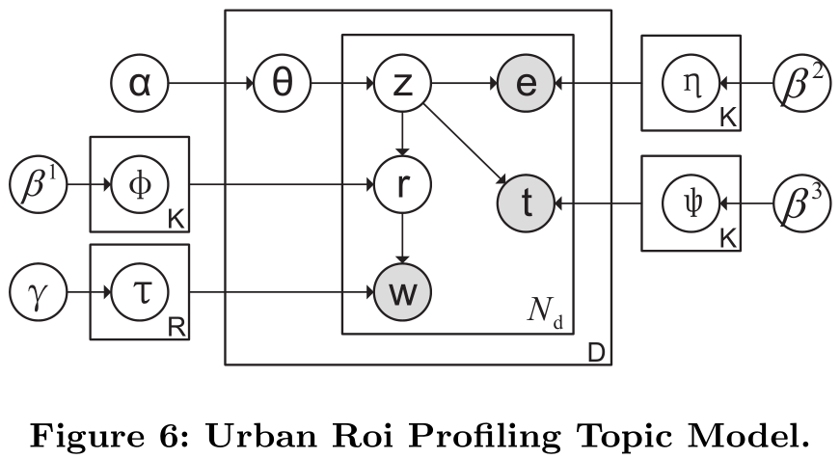
Introduction
Region-of-Interest (ROI)
ROIs help us to know about the city
1、ROI Discover
2、ROI Profile

Slide 10
Our Approach
2

Slide 11
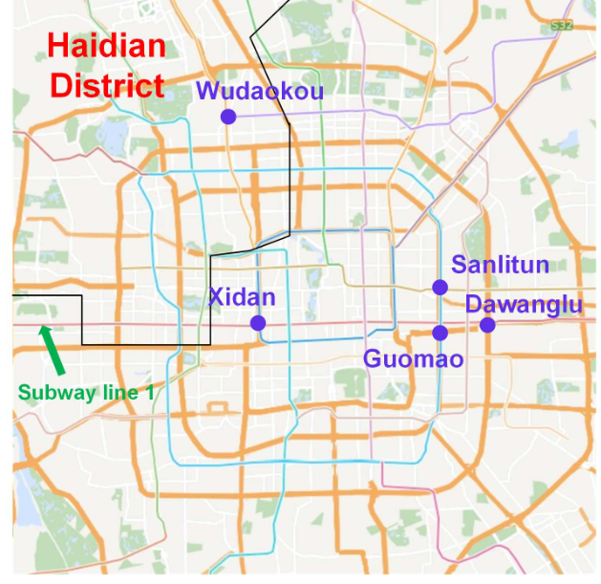
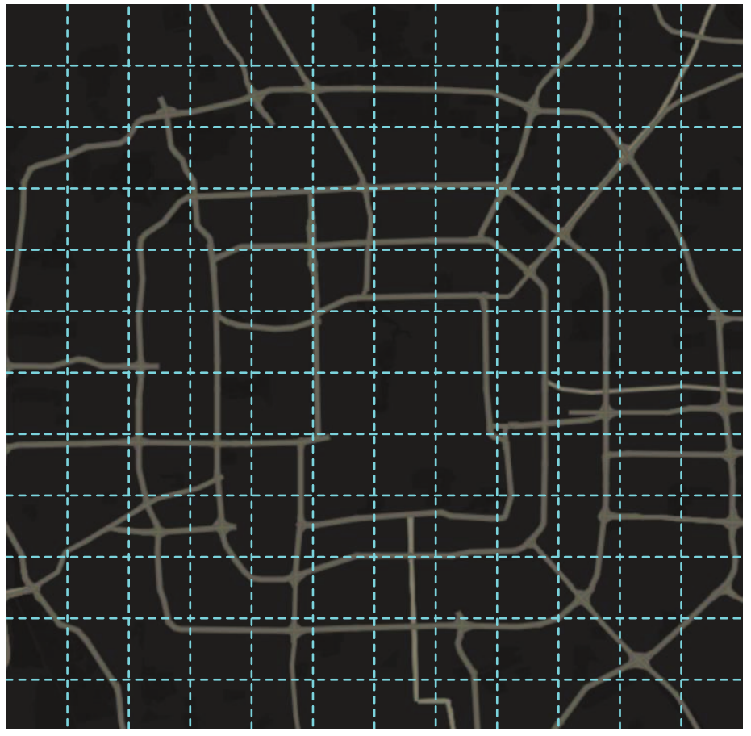
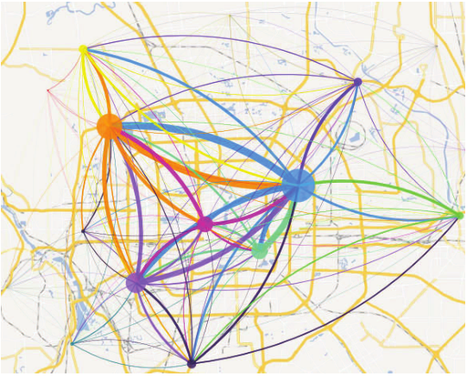
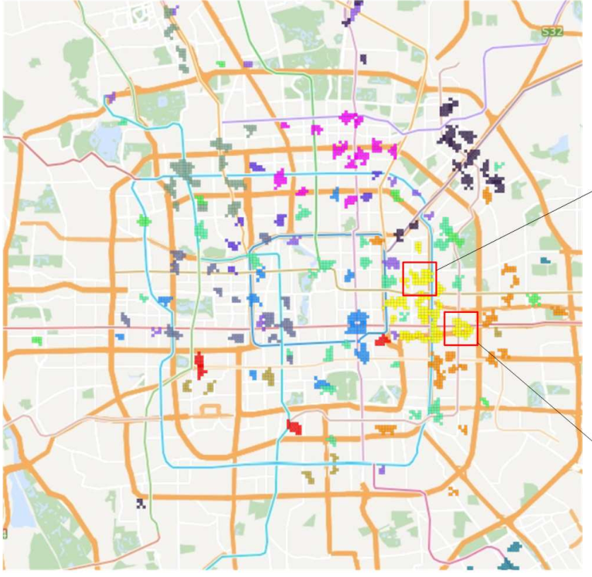
Our Approach
ROI Discover
1. Partial Order
Region Split
Flow Extraction
Urban area of Beijing
Grid-based partition
Urban travel flows
Density-based Clustering for ROI Detection

Slide 12
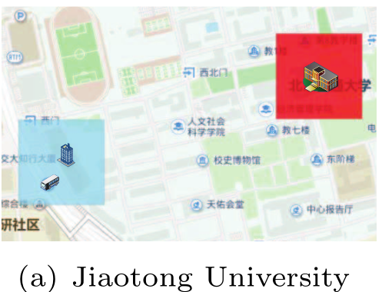
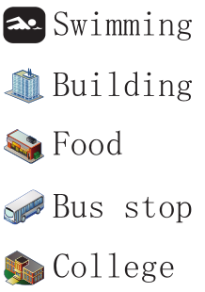
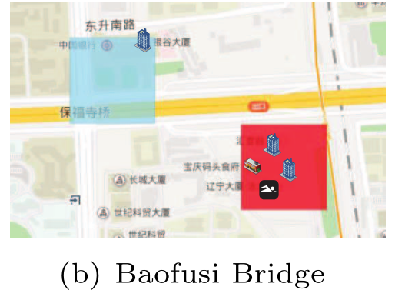
Our Approach
ROI Discover
Frequency Vs. PageRank

Slide 13
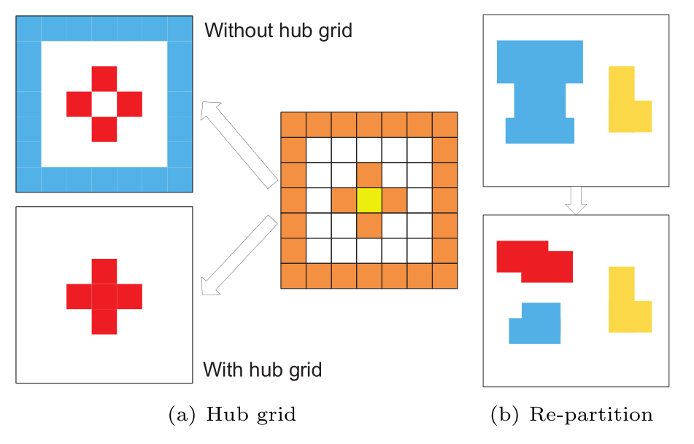
Our Approach
ROI Discover
Density-based Clustering for ROI Detection
· Choose the thresholds.
· Find candidate grids to cluster
· have a popular neighborood(hub grid)
· popular grid
· Get clusters
· Rise the thresholds and repeat the process inside the large clusters

Slide 14
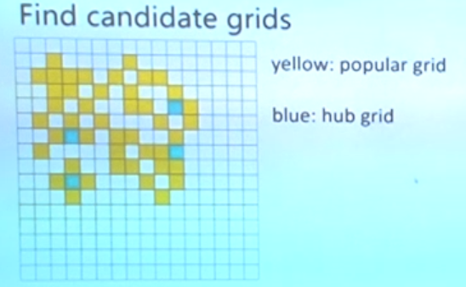
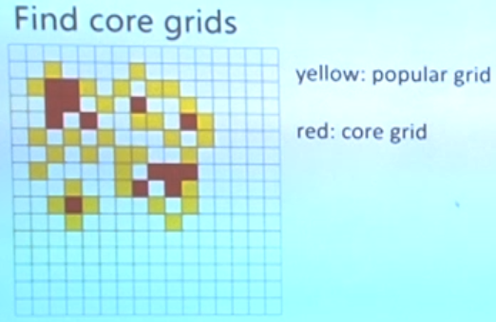
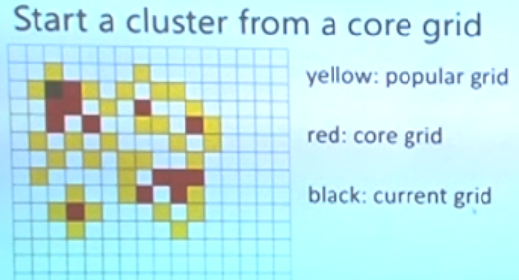
Our Approach
ROI Discover
Density-based Clustering for ROI Detection

Slide 15
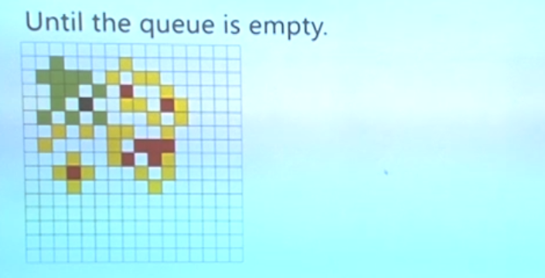
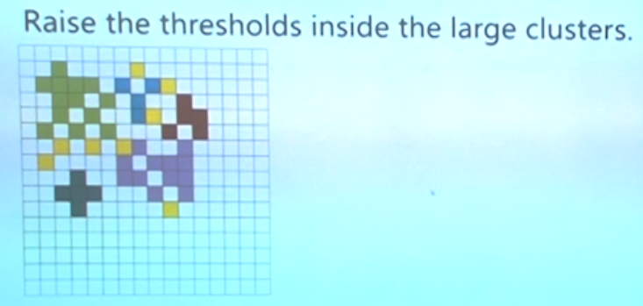
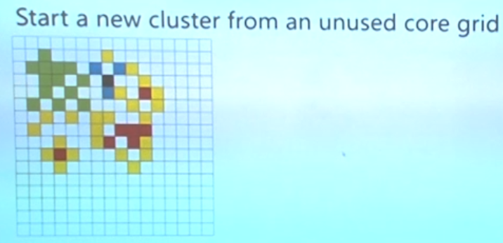
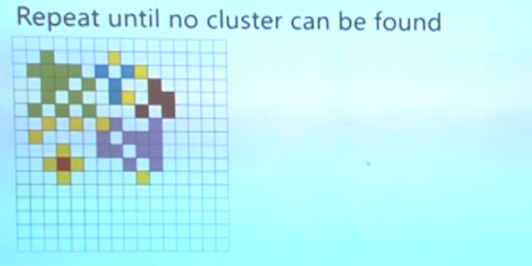
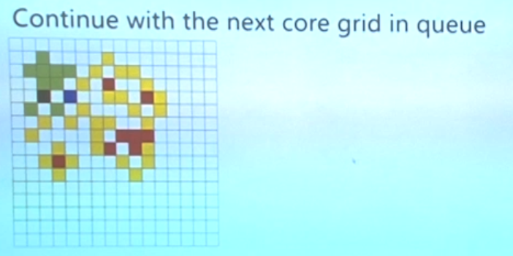
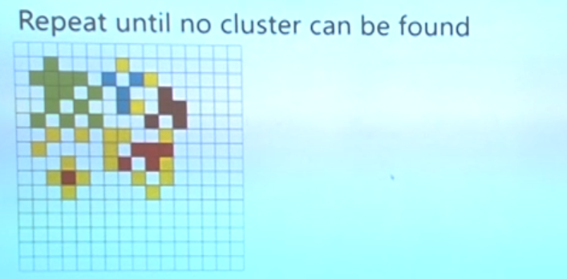
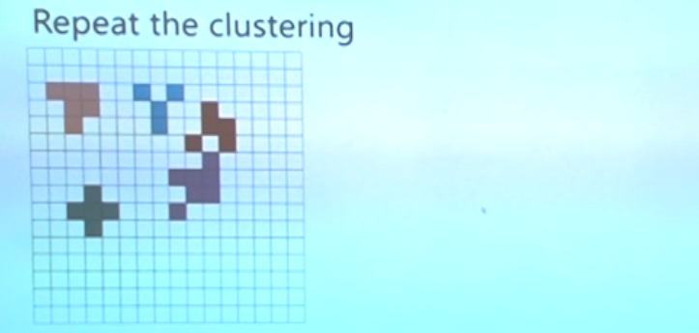
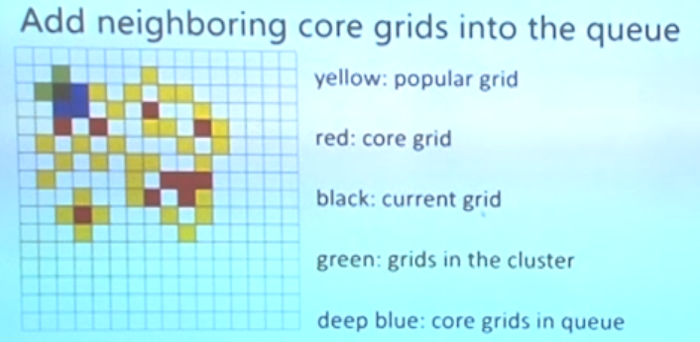
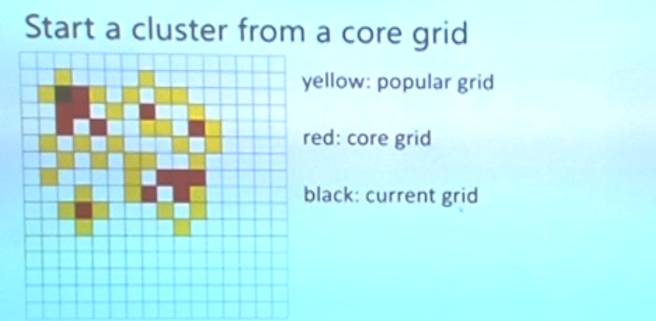
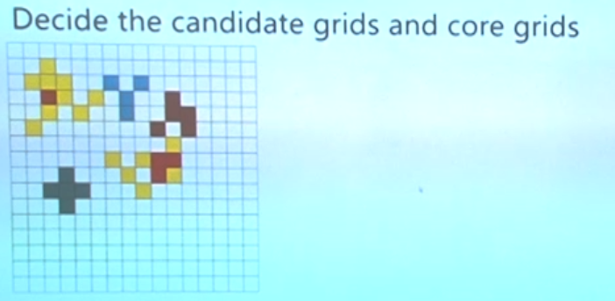
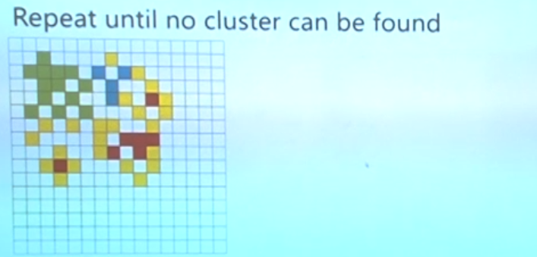
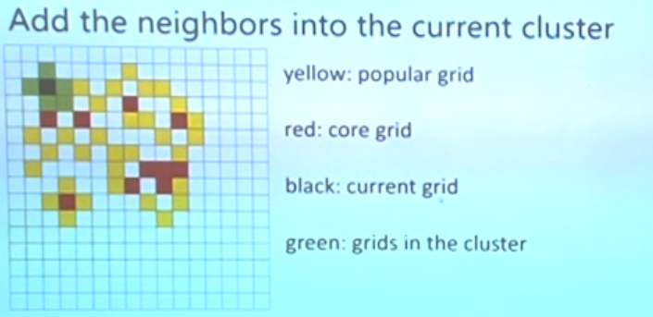
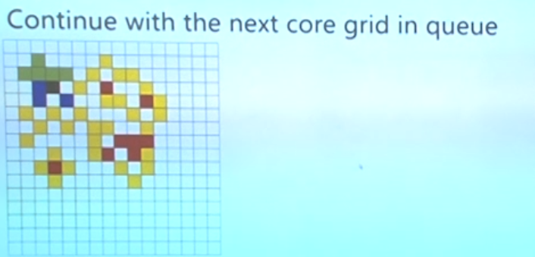
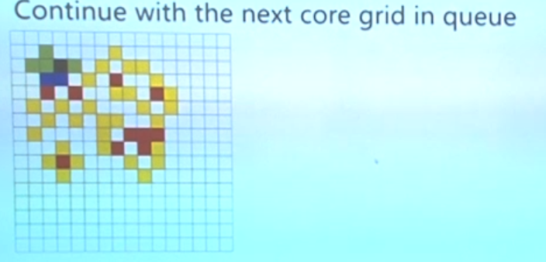
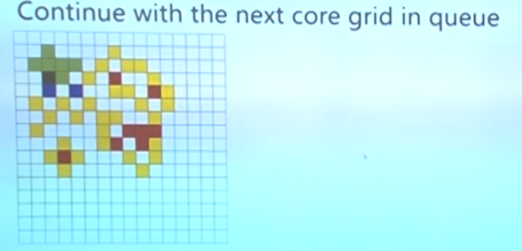
Our Approach
ROI Discover
Density-based Clustering for ROI Detection

Slide 16
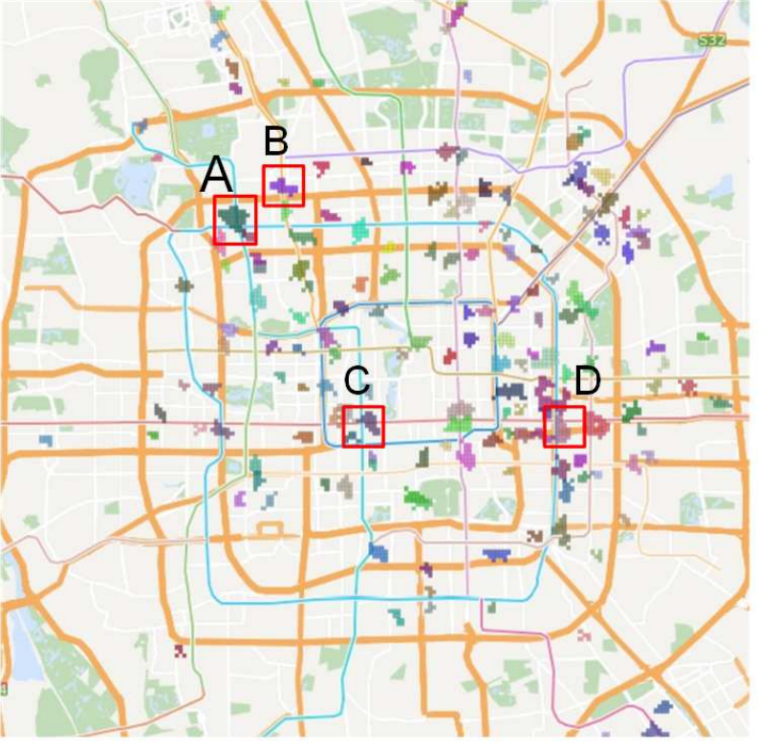
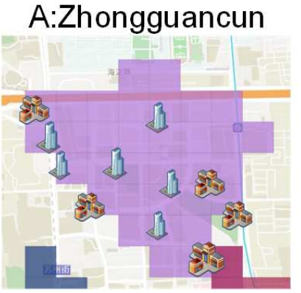
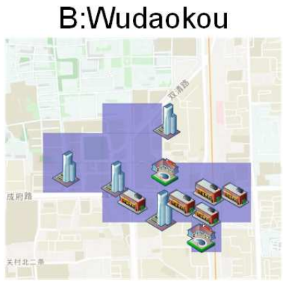
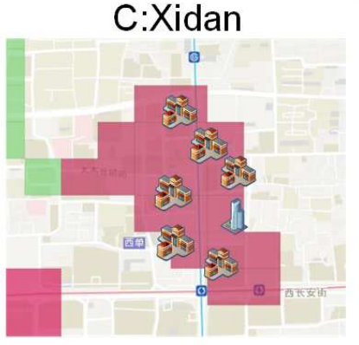
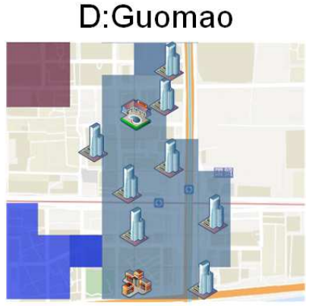
Our Approach
ROI Discover
Density-based Clustering for ROI Detection

Slide 17
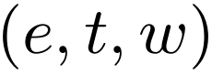
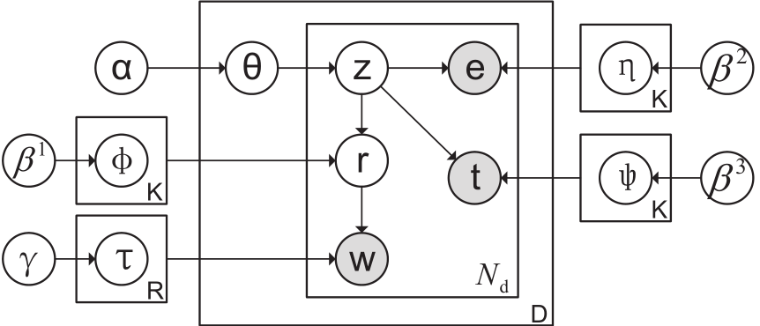
Our Approach
ROI Profile
Urban Roi Profiling Topic Model (URPTM)
e :category of searched POI
t : time stamp of the query
w :GPS coordinates of origin location

Slide 18
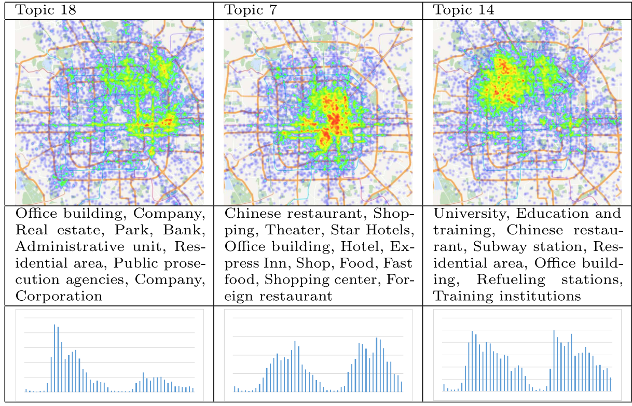
Our Approach
ROI Profile
Urban Roi Profiling Topic Model (URPTM)
Work
Food
College
Origin distribution of
the topic
major POI categories contained in
the topics
temporal distribution
of the topic

Slide 19
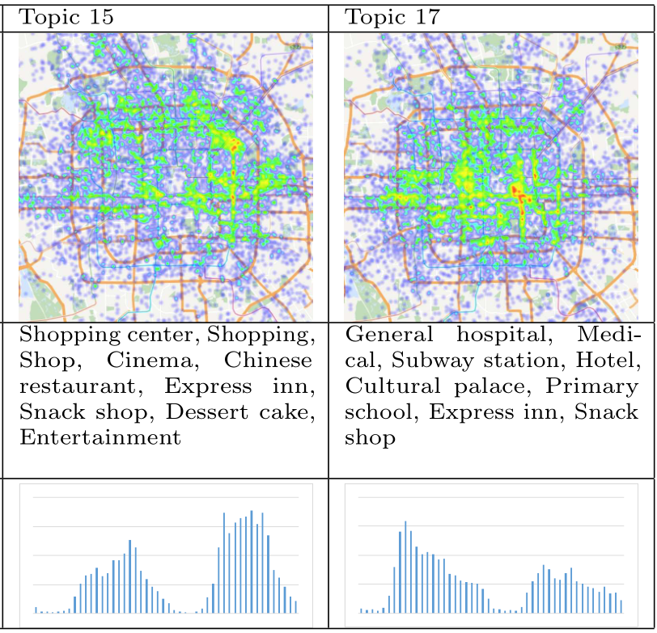
Our Approach
ROI Profile
Urban Roi Profiling Topic Model (URPTM)
Shopping
Medical Care
spatial distribution of
the topic
major POI categories contained in
the topics
temporal distribution
of the topic

Slide 20
Experimental
3

Slide 21
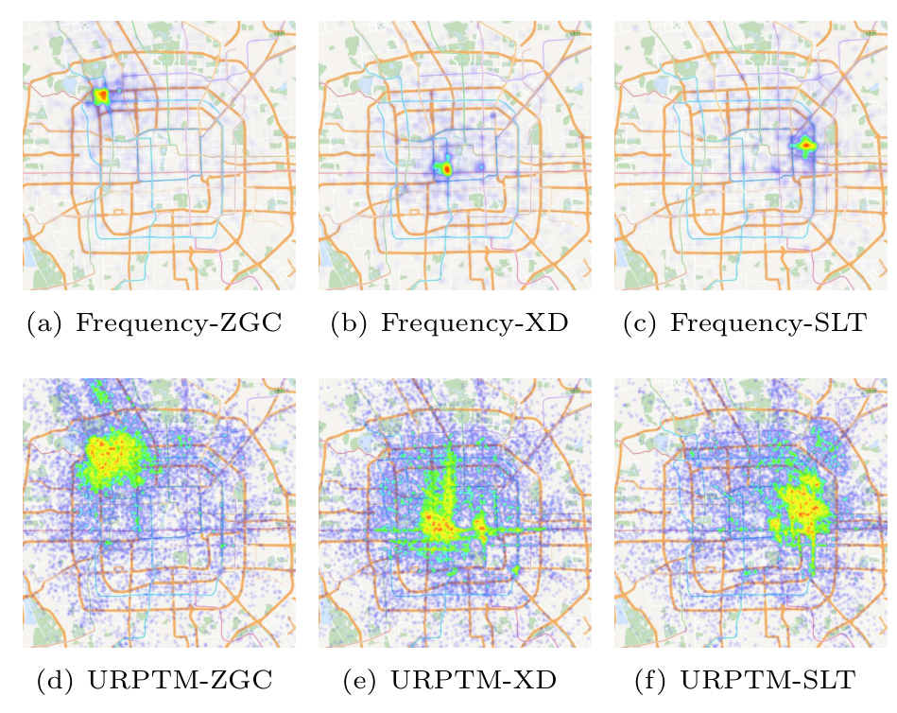
Experimental
estimating the
origins of visitors in ROI

Slide 22
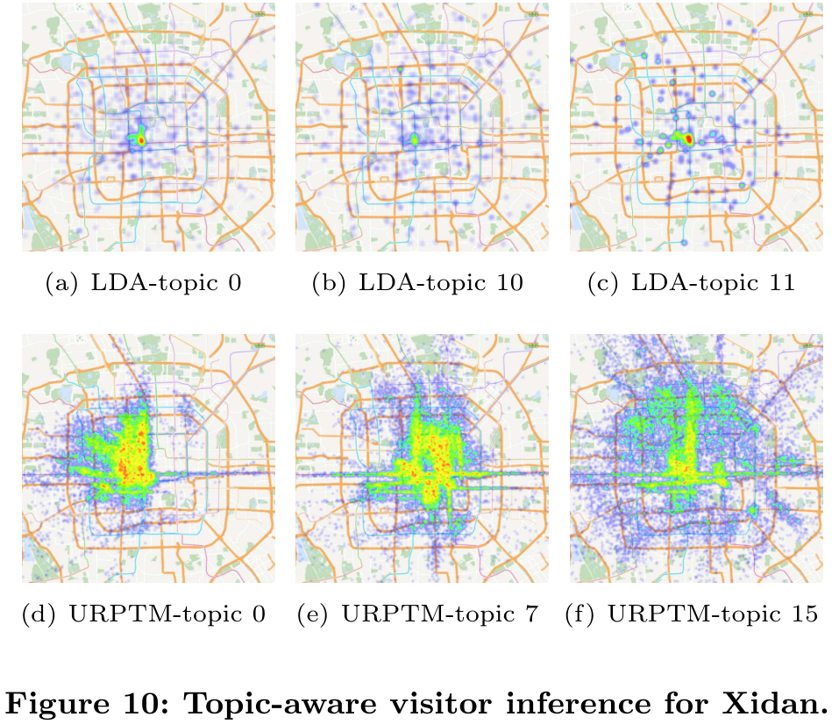
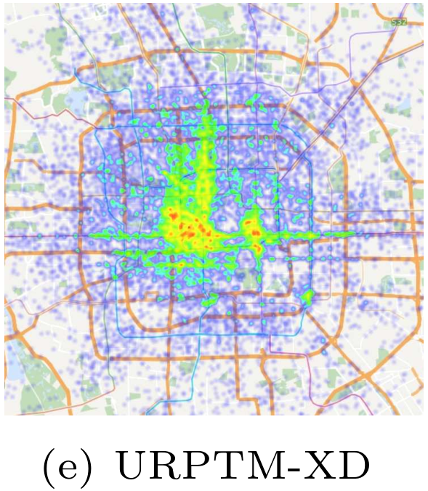
Experimental
Restaurent
Shopping

Slide 23
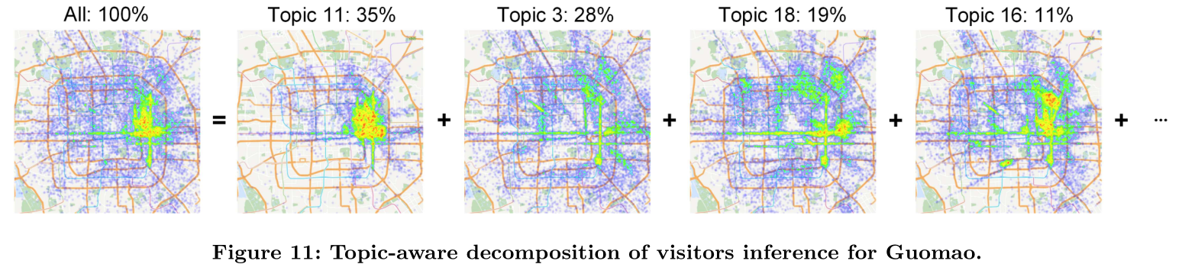
Experimental

Slide 24
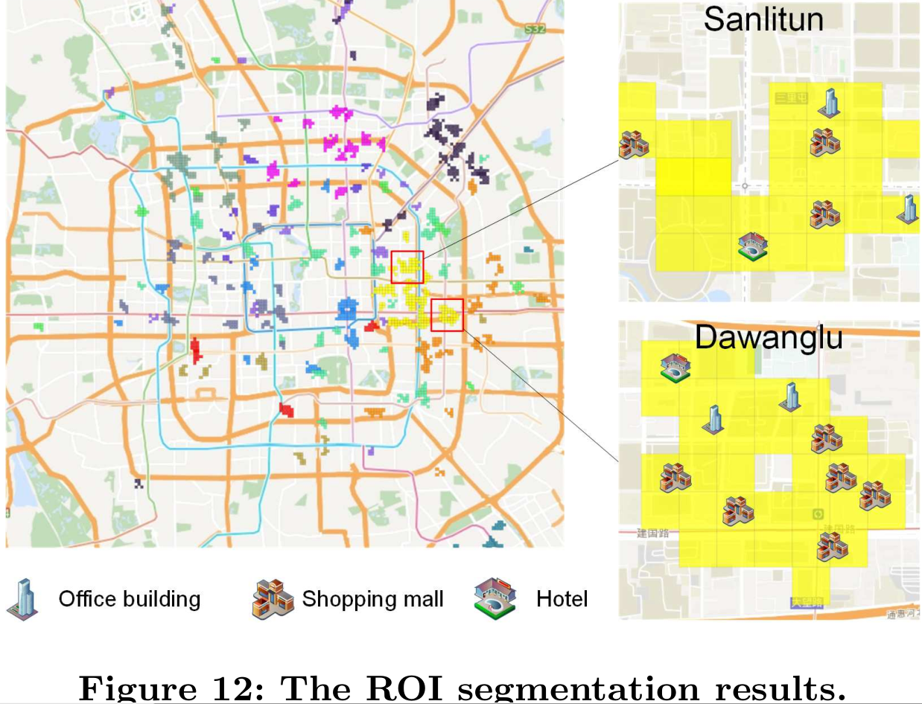
Experimental
ROI segmentation plays an important role for urban business planning
someone wants to open a cafe at Sanlitun but for some reason has to change the location, Dawanglu is another good choice

Slide 25
Conclusion
4

Slide 26
Conclusion
Urban Region-of-Interest (ROI) attract people’s attentions and activities
ROI Discover
Region Split
Use online map
search queries
Flow Extraction
(PageRank)Density-based Clustering for ROI Detection
ROI Profile
Urban Roi Profiling Topic Model (URPTM)

Slide 27
Thanks for your time!

